Slide 1
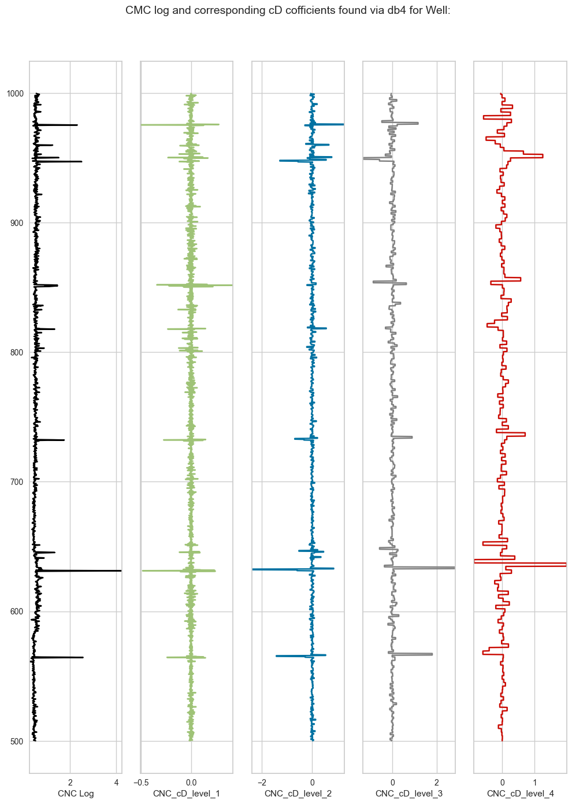

Sonic Log Predictions: XGBoost and Wavelet Transform
Exploring Techniques, and Applications for reliable sonic log predictions.
By: Katherine Grey

Slide 2
Introduction to Sonic Log Predictions
Significance of Sonic Logs
Challenges of Incomplete Data
Sonic log data is crucial for maximizing oil production during drilling operations.
Inaccurate sonic log data can lead to significant financial losses in oil extraction.
Machine Learning Solutions
Machine learning models enhance accuracy by predicting missing sonic log data. Ensemble methods best suited for this problem
Sonic Log Predictions: Innovations and Insights
1
Notes:
Sonic logs are used in various drilling operations to reveal key features of the ground that will be drilled. Features like porosity, elastic modulous,. This is done by probigating ultrasonic waves in the ground and then calculating the delta T or time of flight of the returning wave.

Slide 3
Cost Implications of Sonic Logs
Sonic Log Costs
Financial Risks of Gaps
Savings from Accuracy
The cost of generating sonic logs can reach tens of thousands of dollars per bore.
Inaccurate predictions can result inefficient and costly productions from reservoirs.
Accurate predictions of sonic logs can lower operational costs significantly.
Sonic Log Predictions: Innovations and Insights
3

Slide 4
Traditional vs. Machine Learning Approaches
Traditional Methods
Machine Learning Models
Generating sonic logs is costly, often exceeding tens of thousands of dollars per log.
These methods frequently lead to inaccuracies due to missing or incomplete data.
Traditional approaches rely on experimental formulas that may not capture complex relationships.
Overall, they are less efficient in resource allocation and data analysis.
Machine learning models can predict missing data, significantly reducing costs.
They improve accuracy in sonic log predictions, especially with techniques like XGBoost.
Wavelet transformation enhances the model's ability to identify complex relationships.
This approach allows for better resource allocation and more frequent data analysis.
Sonic Log Predictions: Innovations and Insights
4

Slide 5
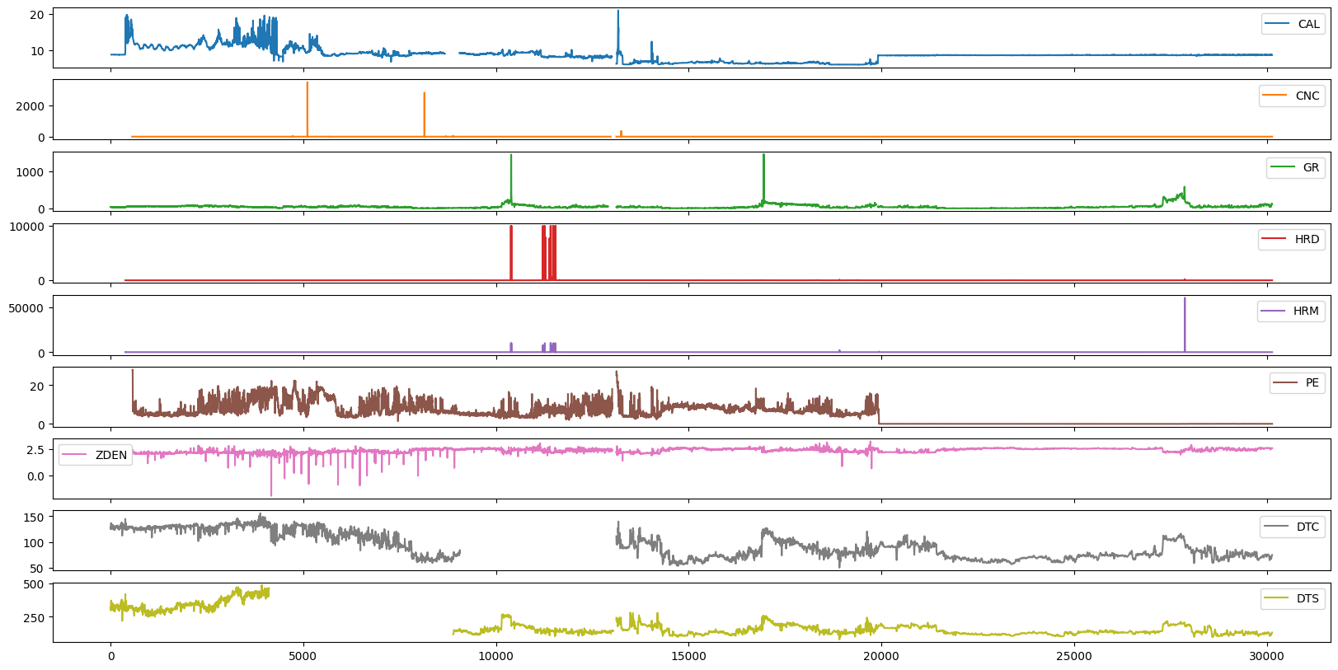
Key Features of Sonic Logs
CAL
CNC
GR
Caliper measurement in inches.
It assesses the borehole diameter.
Neutron measurement in dec.
It determines the hydrogen content in the formation.
Gamma Ray measurement in API.
It indicates the presence of shale.
HRD
HRM
Deep Resistivity measurement in Ohm/m.
It evaluates the formation's conductivity.
Medium Resistivity measurement in Ohm/m.
It provides insights into fluid content.
Sonic Log Predictions: Innovations and Insights
2

Slide 6
Steps in Data Preparation
Handle Missing Values
Analyze Skewed Distributions
Create Correlation Matrices
Apply Log Transformations
Utilize Pearson and Kendall Methods
Instances of -999 were identified as missing values.
These were replaced with NaN to avoid negatively impacting the models.
Histograms and box plots were used to visualize the data distributions.
This analysis revealed skewness and the presence of outliers.
Three correlation matrices were generated to explore feature relationships.
The pandas pd.corr() function facilitated the initial correlation analysis.
A log function was applied to normalize the skewed distributions.
This transformation improved the data's suitability for analysis.
Pearson and Kendall methods were employed to assess correlations among features.
Pearson is ideal for linear relationships, while Kendall handles non-linear relationships effectively.
Sonic Log Predictions: Innovations and Insights
5

Slide 7
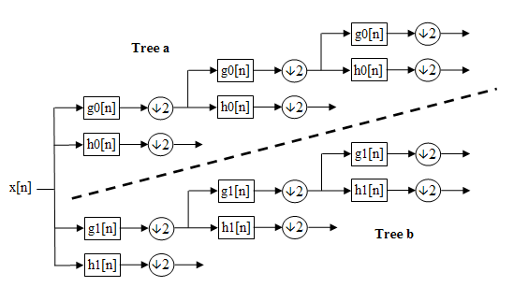
Wavelet Transformation in Sonic Log Analysis
Model Accuracy Enhancement
Wavelet transformation enhances model accuracy by revealing hidden relationships.
Sonic Log Predictions: Innovations and Insights
6

Slide 8
Performance Metrics of the Model
DTC RMSE
DTS RMSE
Overall RMSE
1
2
3
The RMSE for DTC is 4.32 pre-wavelet and 5.38 post-wavelet.
The RMSE for DTS is 23.11 pre-wavelet and 10.35 post-wavelet.
The overall RMSE is 16.62 pre-wavelet and 8.72 post-wavelet.
Sonic Log Predictions: Innovations and Insights
7

Slide 9
Ethical Considerations in Sonic Log Predictions
Strengths
Weaknesses
Machine learning models enhance the accuracy of sonic log predictions.
They can identify complex relationships in data that traditional methods may overlook.
The reliance on machine learning can lead to a lack of transparency in decision-making processes.
Inaccurate models may produce misleading predictions, impacting operational decisions.
S
W
O
T
Opportunities
Threats
There is potential for cross-industry applications of sonic log predictions, expanding their use beyond oil and gas.
Advancements in machine learning techniques can improve the quality and reliability of predictions.
Ethical concerns arise from the potential misuse of predicted data, leading to harmful consequences.
Regulatory scrutiny may increase as the use of machine learning in critical industries grows.
Sonic Log Predictions: Innovations and Insights
9

Slide 10
Applications Beyond Oil and Gas
Bridge Support Applications
Sonic logs inform subsurface conditions in bridge construction.
Sonic Logs in Pile Driving
Sonic logs assess soil properties during pile driving.
Cross-Industry Utility
Sonic logs improve predictive capabilities in engineering.
Sonic Log Predictions: Innovations and Insights
10

Slide 11

Challenges and Limitations
Data Quality Issues
Python Compatibility
Virtual Environments
Data quality significantly limits prediction accuracy.
Insufficient data collection in many logs leads to unreliable results.
Many features required for the project are not supported in Python 3.13.
This has created challenges in utilizing certain functionalities effectively.
Creating virtual environments was necessary to run older Python versions.
This process added complexity and required additional setup time.
Missing Features
Model Accuracy
There is a need to develop a pipeline feature for handling sonic log data with missing attributes.
Current implementations do not adequately address the challenges of incomplete data.
Ensuring model accuracy is crucial when predicting missing sonic log data.
Inaccurate predictions can lead to significant financial consequences.
Sonic Log Predictions: Innovations and Insights
11

Slide 12
Conclusion and Recommendations
Project Findings
Wavelet Transformation Benefits
Future Work Recommendations
The project improved the accuracy of sonic log data predictions using machine learning.
Wavelet transformation enhanced model performance by revealing stronger correlations.
Future work should focus on developing a pipeline feature.
Sonic Log Predictions: Innovations and Insights
12

